Slide 1
Web Design and Development
Day:21
HTML
UI
</>
UX

Slide 2
DAY 21 session
03
Web Design and Development (Bootstrap. WordPress)

Slide 3

Bootstrap
Bootstrap is an open source JavaScript framework developed by Twitter's team of designers and developers.
It is also called as a front-end-framework.
It contains HTML, CSS-based design templates for forms, buttons, and navigation and other interface components, as well as optional JavaScript extensions.

Slide 4
Reason to choose Bootstrap
Faster and Easier Web-Development.
It creates Platform-independent web-pages.
It creates Responsive Web-pages.
It’s designed to be responsive to mobile devices too.
It’s Free! Available on www.getbootstrap.com

Slide 5
Bootstrap components
CSS
FONTS
JavaScript

Slide 6
Installing Bootstrap
BootstrapCDN
Compiled CSS and JS
Method (1)
Method (2)

Slide 7
basic html document
00
Index.html
<!DOCTYPE html>
<html lang="en">
<head>
<meta charset="utf-8">
<title>Learning Bootstrap @ CEDP </title>
<meta name="description" content="Hello World">
</head>
<body>
<div> Hello World!</div>
<div> You're learning Bootstrap on CEDP</div>
</body>
</html>

Slide 8
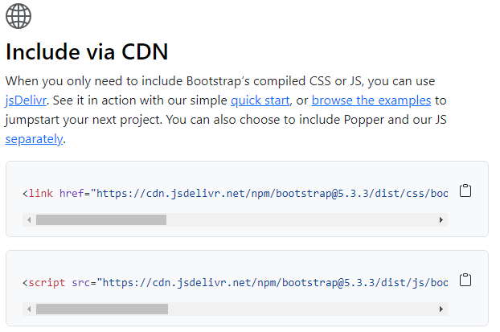
01
Step 1
BootstrapCDN
Goto getbootstrap and click Getting Started . Scroll down.

Slide 9
02
Step 2
BootstrapCDN
Index.html
<!DOCTYPE html>
<html lang="en">
<head>
<meta charset="utf-8">
<title>Learning Bootstrap @ CEDP </title>
<meta name="description" content="Hello World">
<link rel="stylesheet" href= https://stackpath.bootstrapcdn.com/bootstrap/4.3.1/css/bootstrap.min.css
integrity= "sha384-ggOyR0iXCbMQv3Xipma34MD+dH/1fQ784/j6cY/iJTQUOhcWr7x9JvoRxT2MZw1T"
crossorigin="anonymous">
</head>
<body>
<div> Hello World!</div>
<div> You're learning Bootstrap on CEDP</div>
</body>
</html>
Copy the <link> and paste it in the head section of the HTML code.

Slide 10
03
Step 3
BootstrapCDN
Index.html
<!DOCTYPE html>
<html lang="en">
<head>
<meta charset="utf-8">
<title>Learning Bootstrap @ CEDP </title>
<meta name="description" content="Hello World">
<link rel="stylesheet" href= https://stackpath.bootstrapcdn.com/bootstrap/4.3.1/css/bootstrap.min.css
integrity= "sha384-ggOyR0iXCbMQv3Xipma34MD+dH/1fQ784/j6cY/iJTQUOhcWr7x9JvoRxT2MZw1T“ crossorigin="anonymous">
</head>
<body>
<div> Hello World!</div>
<div> You're learning Bootstrap on CEDP</div>
<script src= https://code.jquery.com/jquery-3.3.1.slim.min.js integrity= "sha384-q8i/X+965DzO0rT7abK41JStQIAqVgRVzpbzo5smXKp4YfRvH+8abtTE1Pi6jizo"
crossorigin="anonymous">
</script>
<script src= https://cdnjs.cloudflare.com/ajax/libs/popper.js/1.14.7/umd/popper.min.js integrity= "sha384-UO2eT0CpHqdSJQ6hJty5KVphtPhzWj9WO1clHTMGa3JDZwrnQq4sF86dIHNDz0W1"
crossorigin="anonymous">
</script>
<script src= https://stackpath.bootstrapcdn.com/bootstrap/4.3.1/js/bootstrap.min.js integrity= "sha384-JjSmVgyd0p3pXB1rRibZUAYoIIy6OrQ6VrjIEaFf/nJGzIxFDsf4x0xIM+B07jRM"
crossorigin="anonymous">
</script>
</body>
</html>
Copy the <script> tag and paste those things in the body section at bottom position like the above code.

Slide 11
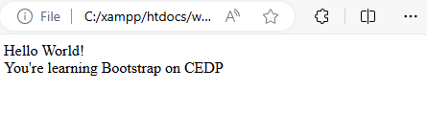

04
Step 4
BootstrapCDN
Index.html
Run both the HTML files

Slide 12
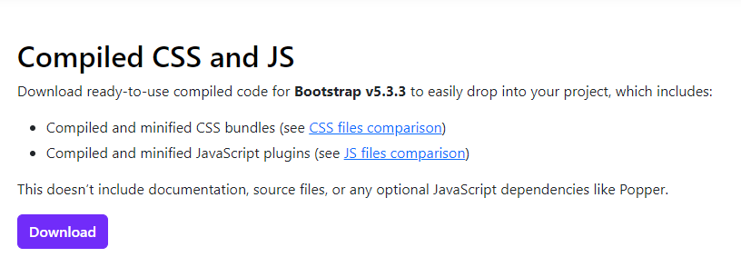
01
Step 1
Compiled CSS and JS
Goto getbootstrap and click Getting Started. Click on the Download Bootstrap button and download the compiled CSS and JS.

Slide 13
02
Step 2
Compiled CSS and JS
<!DOCTYPE html>
<html lang="en">
<head>
<meta charset="utf-8">
<title>Learning Bootstrap @ CEDP </title>
<meta name="description" content="Hello World">
<link rel="stylesheet" type="text/css“ href="css/bootstrap.min.css">
</head>
<body>
<div> Hello World!</div>
<div> You're learning Bootstrap on CEDP</div>
<script src="js/bootstrap.min.js"></script>
<script src=
"https://ajax.googleapis.com/ajax/libs/jquery/2.1.3/jquery.min.js">
</script>
</body>
</html>
A.zip file would get downloaded. Extract it and go into the distribution folder. You would see 2 folders named CSS and JS. You can make your HTML file there and then you must paste these links in their respective sections.

Slide 14
SOME examples
https://www.w3schools.com/bootstrap/

Slide 15

XAMPP
XAMPP is one of the widely used cross-platform web servers, which helps developers to create and test their programs on a local webserver.
XAMPP is an abbreviation where
X stands for Cross-Platform
A stands for Apache
M stands for MYSQL and
PP stand for PHP and Perl

Slide 16
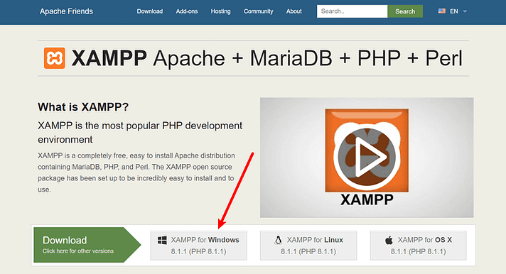
XAMPP installation

Slide 17
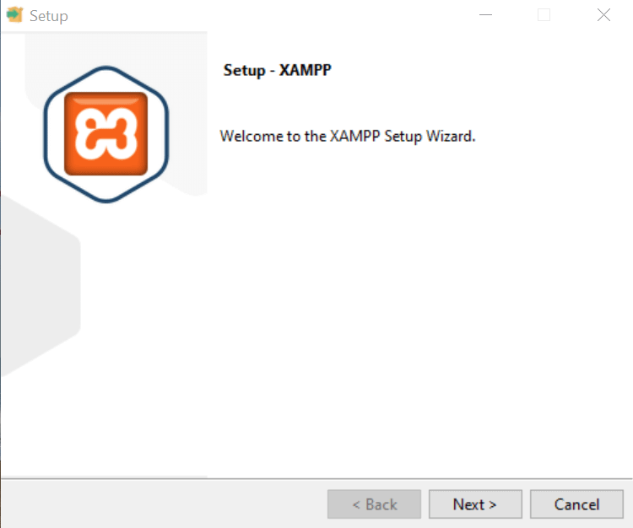
XAMPP installation

Slide 18
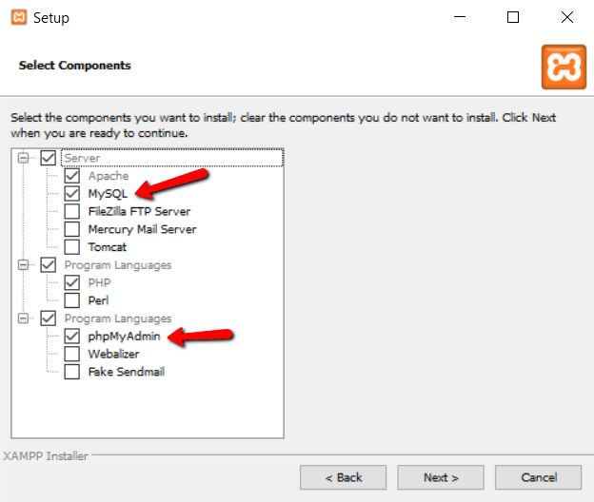
XAMPP installation

Slide 19
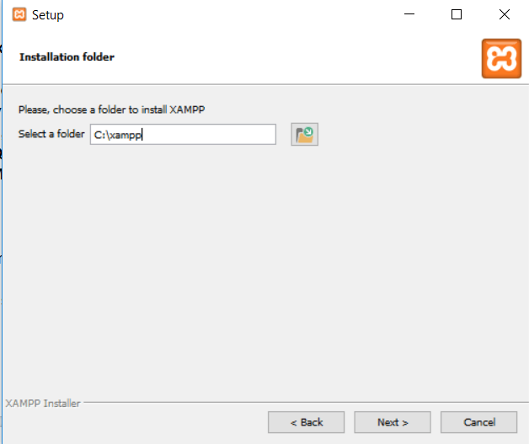
XAMPP installation

Slide 20
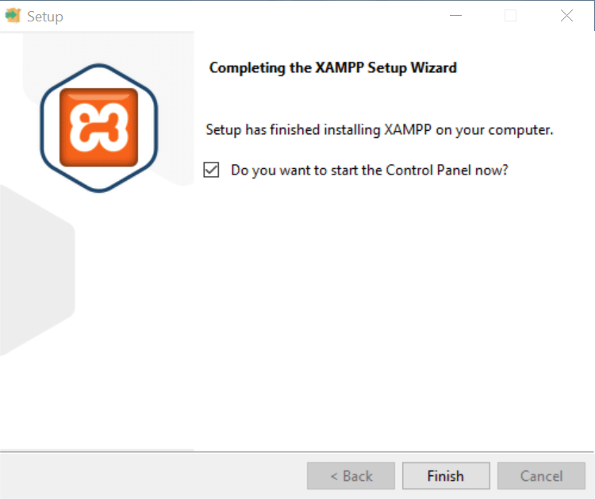
XAMPP installation

Slide 21
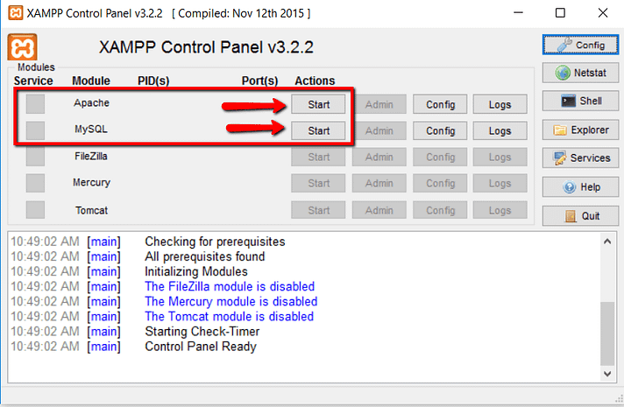
XAMPP Control panel

Slide 22
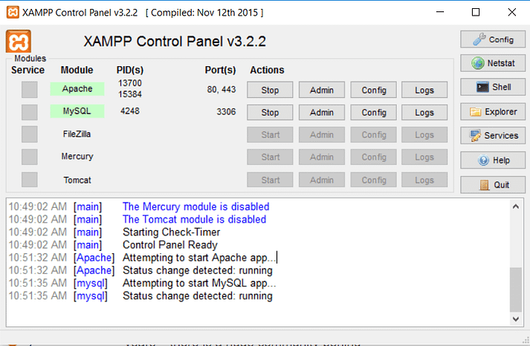
XAMPP Control panel

Slide 23
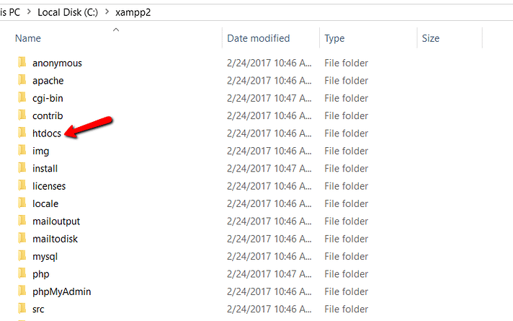
XAMPP content location

Slide 24
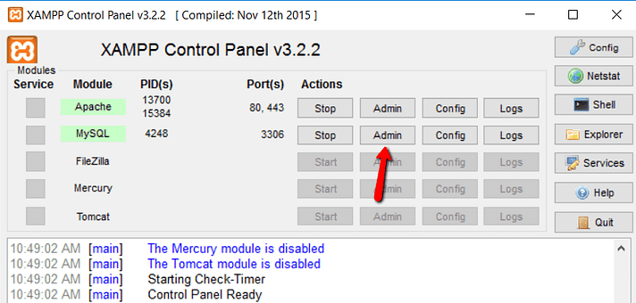
XAMPP mysql interface

Slide 25
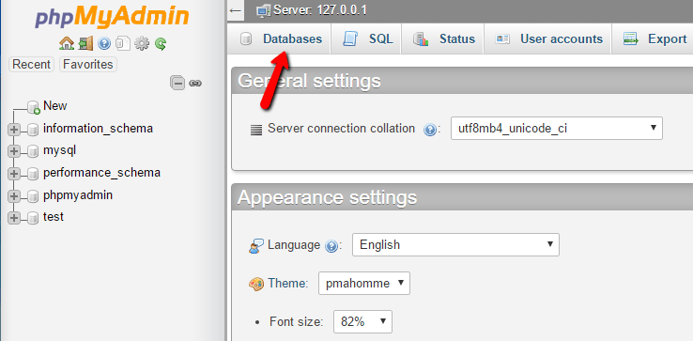
Mysql database creation

Slide 26
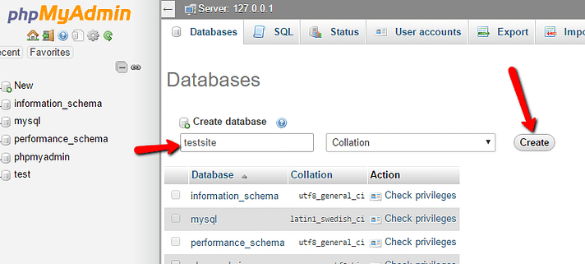
Mysql database creation

Slide 27
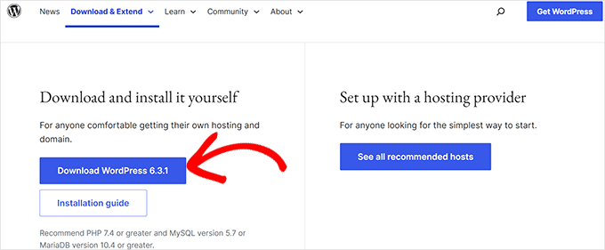
Wordpress download

Slide 28
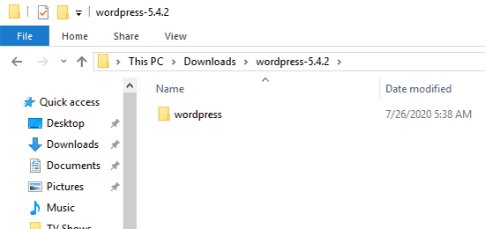
Wordpress download

Slide 29
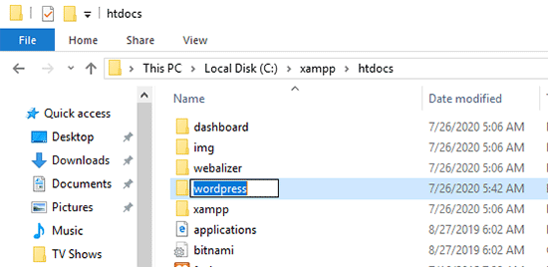
Wordpress in xampp

Slide 30
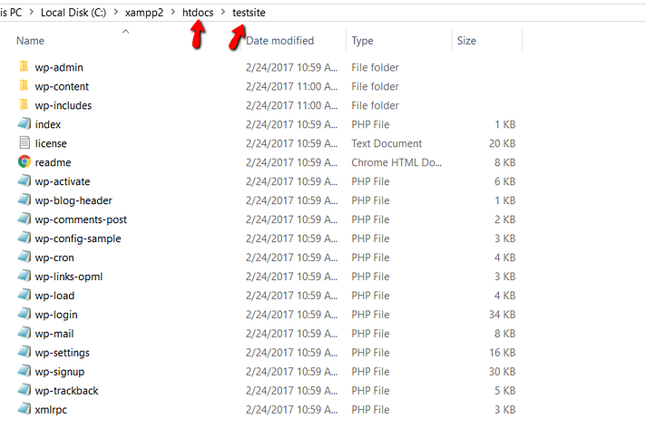
Wordpress in xampp

Slide 31
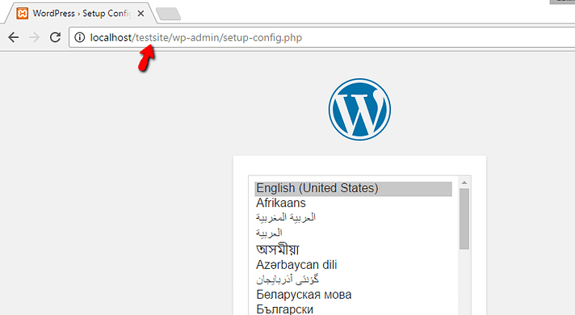
Wordpress installation

Slide 32
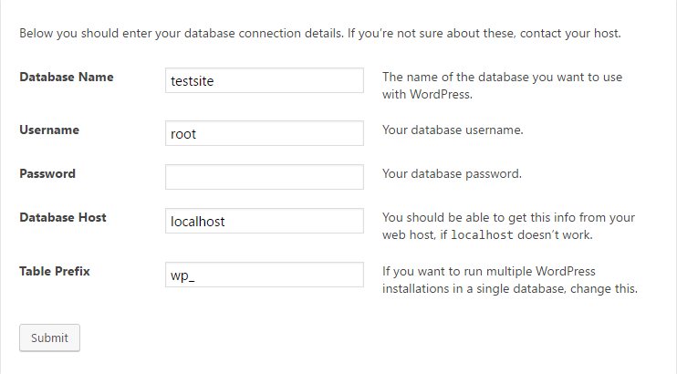
Wordpress database information

Slide 33
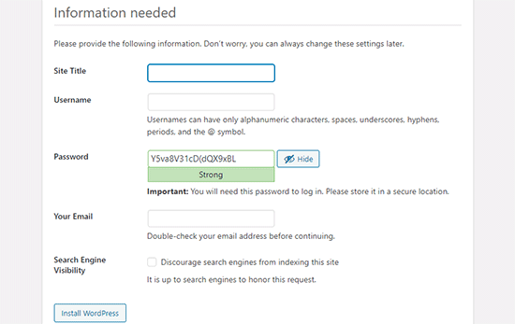
Wordpress admin information

Slide 34
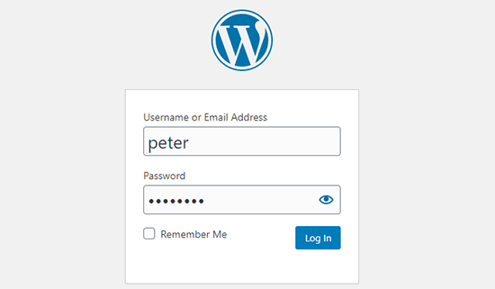
Wordpress login

Slide 35
PHP Programming with WORDPRESS

Slide 36
Lets CREATE A PLUGIN: simple-plugin

Slide 37
Step 1: Go TO ADMIN Panel
Paste this link in the browser
http://localhost/testsite/wp-admin/
You will be able to see the admin panel from here.

Slide 38
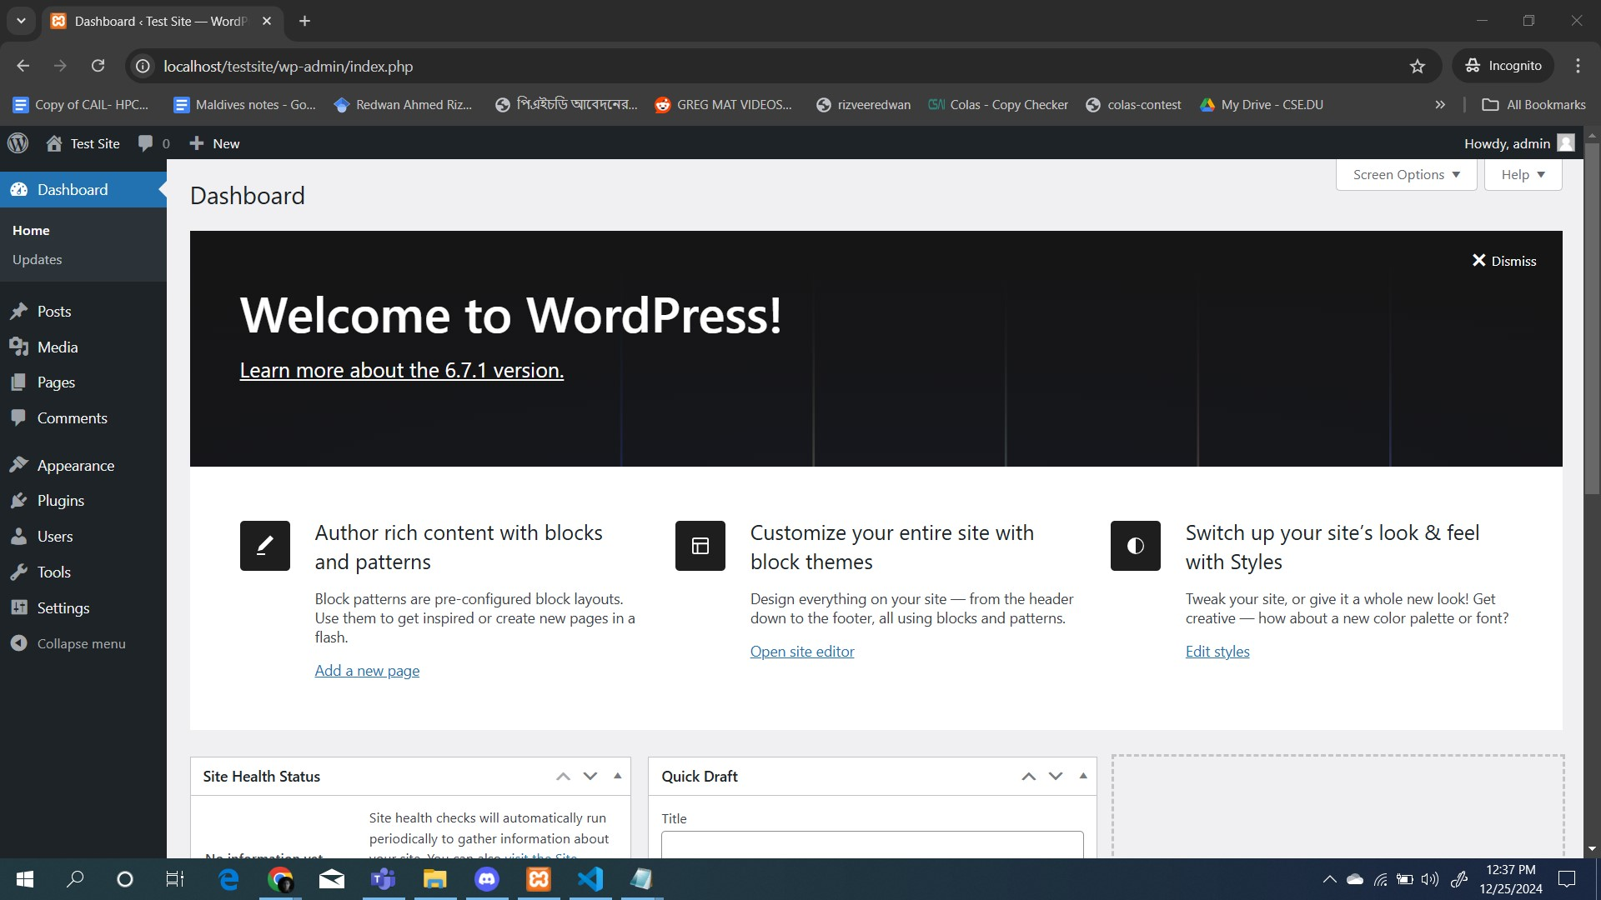
Step 1: Go TO ADMIN Panel

Slide 39
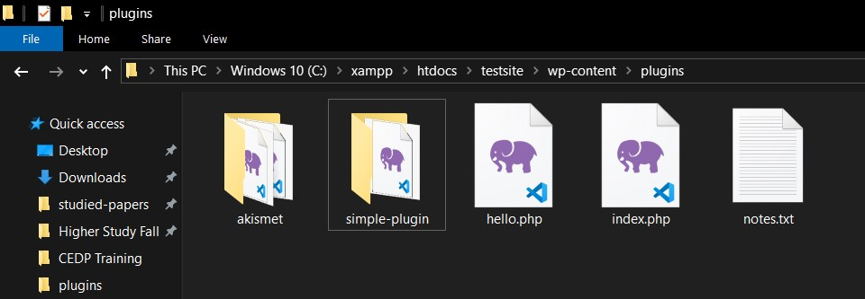
Step 2: Folder CREATION
Create a folder named simple-plugin in this directory
C:\xampp\htdocs\testsite\wp-content\plugins

Slide 40
Step 3: CREATE PHP PLUGIN FILE
Create a file named simple-plugin.php in this folder
Copy code from this link and Paste it to this file.
This file is the plugin file from which we are going to use code
GO THROUGH THE CODE
READ THE COMMENTS FOR EACH LINE

Slide 41
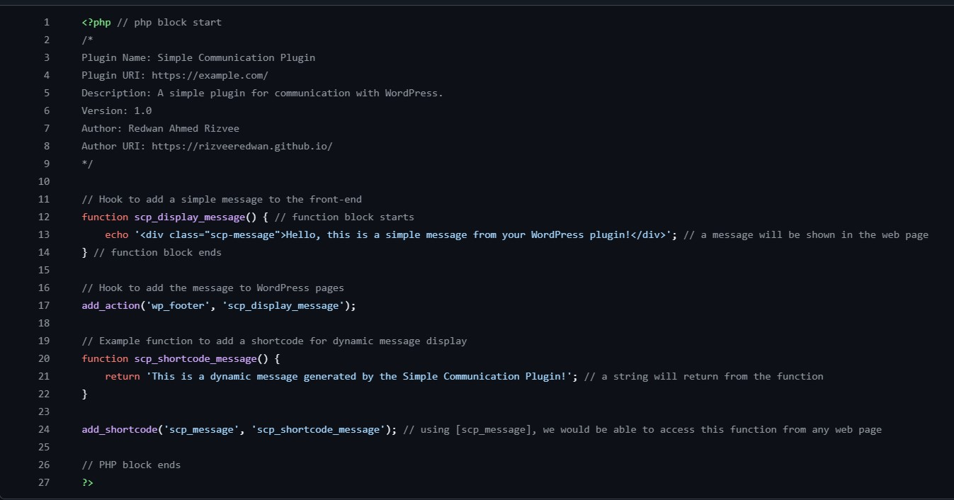

Slide 42
Step 4: PlugIN ACTIVATION
Now go to wordpress to Activate the plugin simple-plugin from the plugin tab
Go to Tab Plugins.
Go to Installed Plugins.
Activate simple-plugin

Slide 43
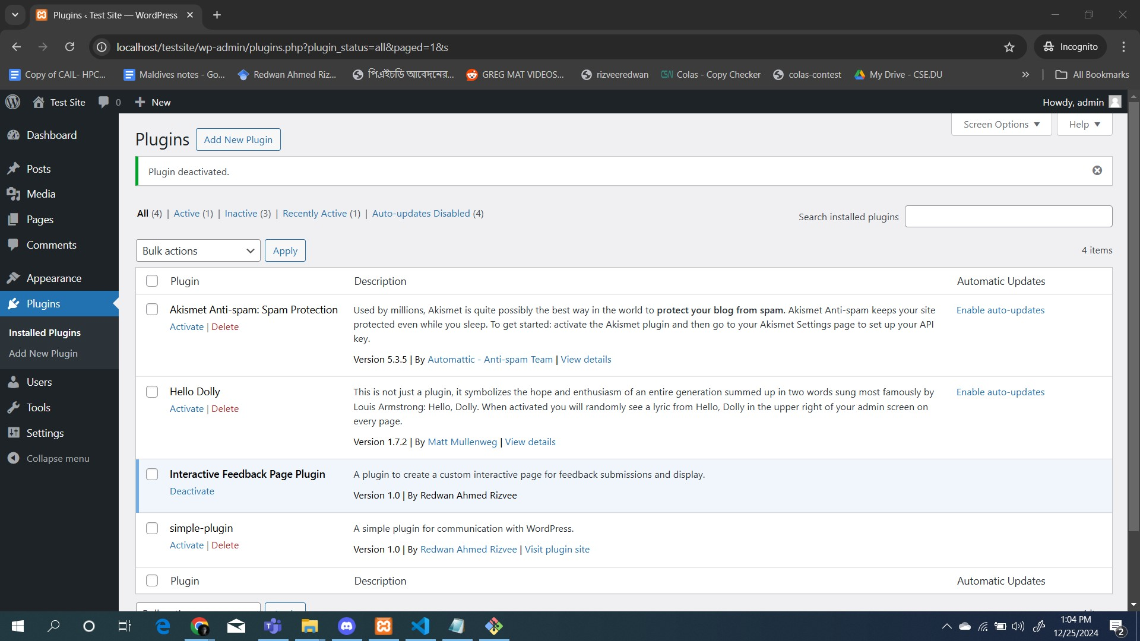
Step 4: PlugIN ACTIVATION

Slide 44
STEP 5: REFRESH the website
After any update always refresh the website.

Slide 45
Step 6: create page & aDD simple-plugin
Create a new page. Name it My First Page.
Type the contents as shown in the page
Save the post
Publish the post
Go to localhost/testsite/my-first-page in your browser
See the output and understand !

Slide 46
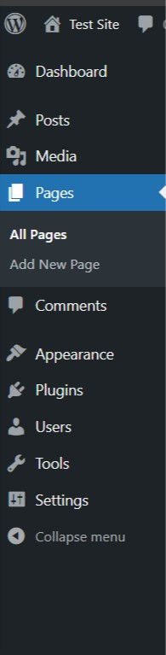
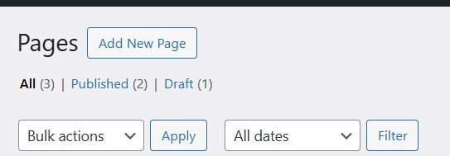
6.1: Create a new page. Name it My First Page.
b)
a)

Slide 47
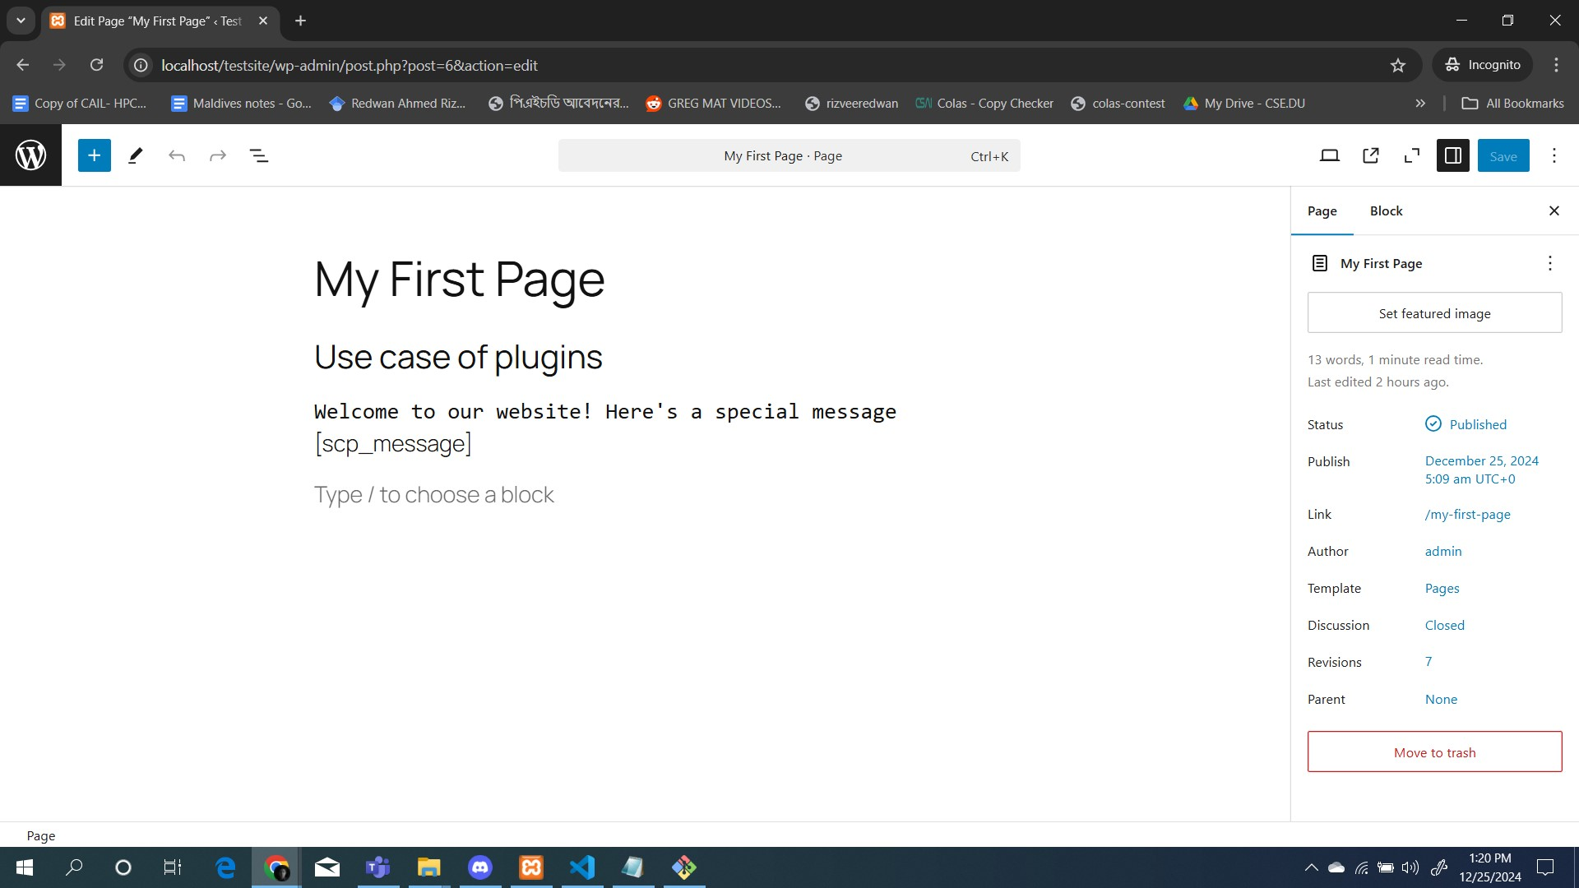
6.2 Type the contents, 6.3 Save the contents and 6.4 publish the page
Publish/Save the contents of the page
be very careful of this segment
Type exactly as it is

Slide 48
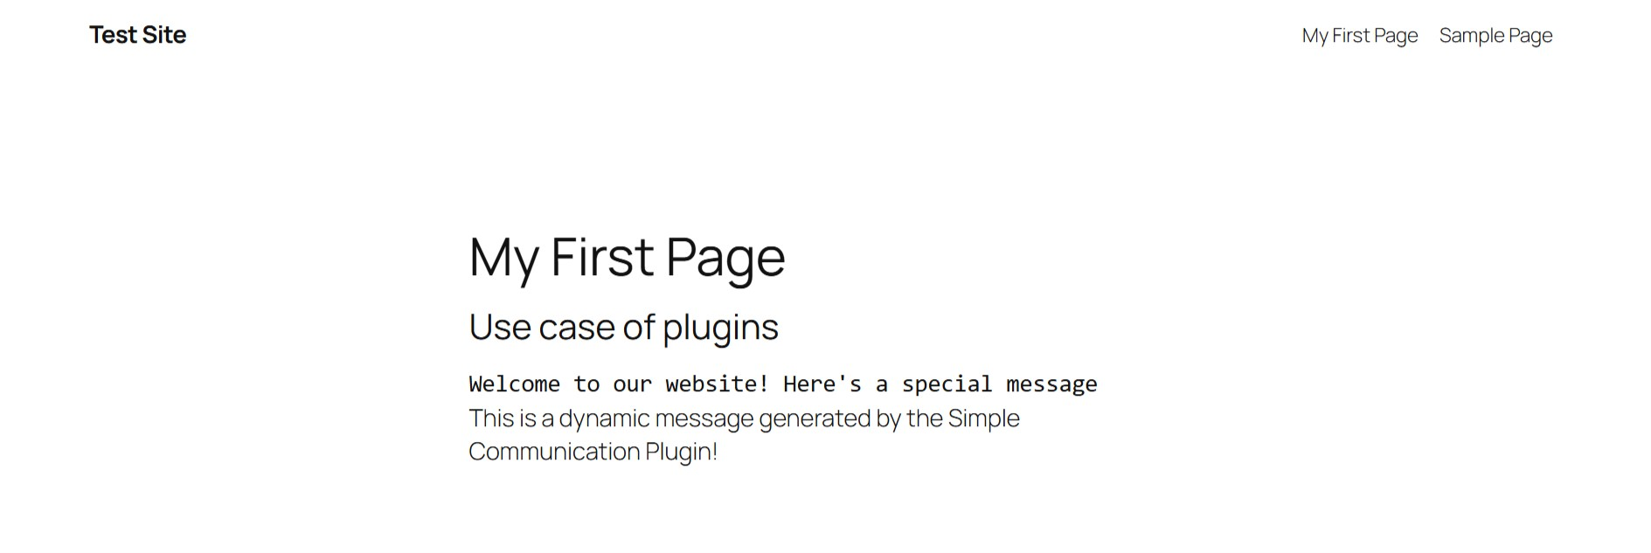
6.5: GO TO PAGE & 6.6 See the contents
Go to localhost/testsite/my-first-page in your browser

Slide 49
MATCH CODE & OUTPUT
SAME STRING IN BOTH

Slide 50
Let’s MAKE ANOTHER PLUGIN feedback-plugin
Use Case of FORM with PHP and DATABASE: MYSQL

Slide 51
Step 1: Go TO ADMIN Panel
Paste this link in the browser
http://localhost/testsite/wp-admin/
You will be able to see the admin panel from here.

Slide 52
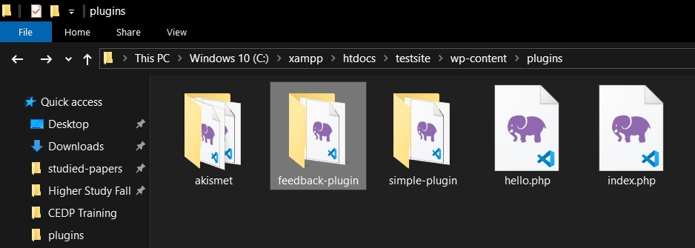
Step 2: Folder CREATION
Create a folder named feedback-plugin in this directory
C:\xampp\htdocs\testsite\wp-content\plugins

Slide 53
Step 3: CREATE PHP PLUGIN FILE
Create a file named feedback-plugin.php in this folder
Copy code from this link and Paste it to this file.
This file is the plugin file from which we are going to use code
GO THROUGH THE CODE
READ THE COMMENTS FOR EACH LINE

Slide 54
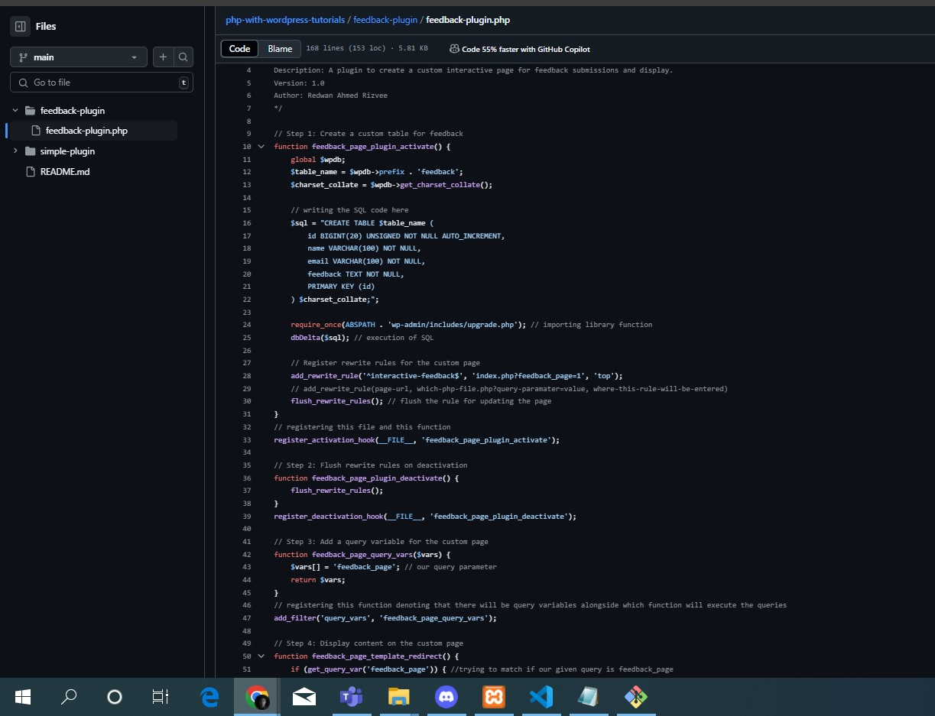
GO THROUGH ThE CODE

Slide 55
Step 4: PlugIN ACTIVATION
Now go to wordpress to Activate the plugin feedback-plugin from the plugin tab
Go to Tab Plugins.
Go to Installed Plugins.
Activate feedback-plugin

Slide 56
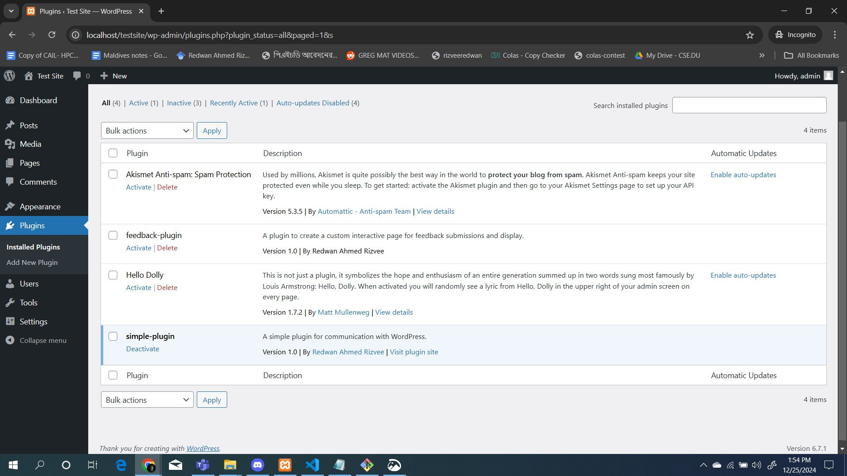

Slide 57
STEP 5: REFRESH the website
After any update always refresh the website.

Slide 58
STEP 6: VISIT The PAGE !
GO TO localhost/testsite/interactive-feedback?feedback_page=1
SEE YOUR PAGE
GIVE INPUT AND SEE THE OUTPUT

Slide 59
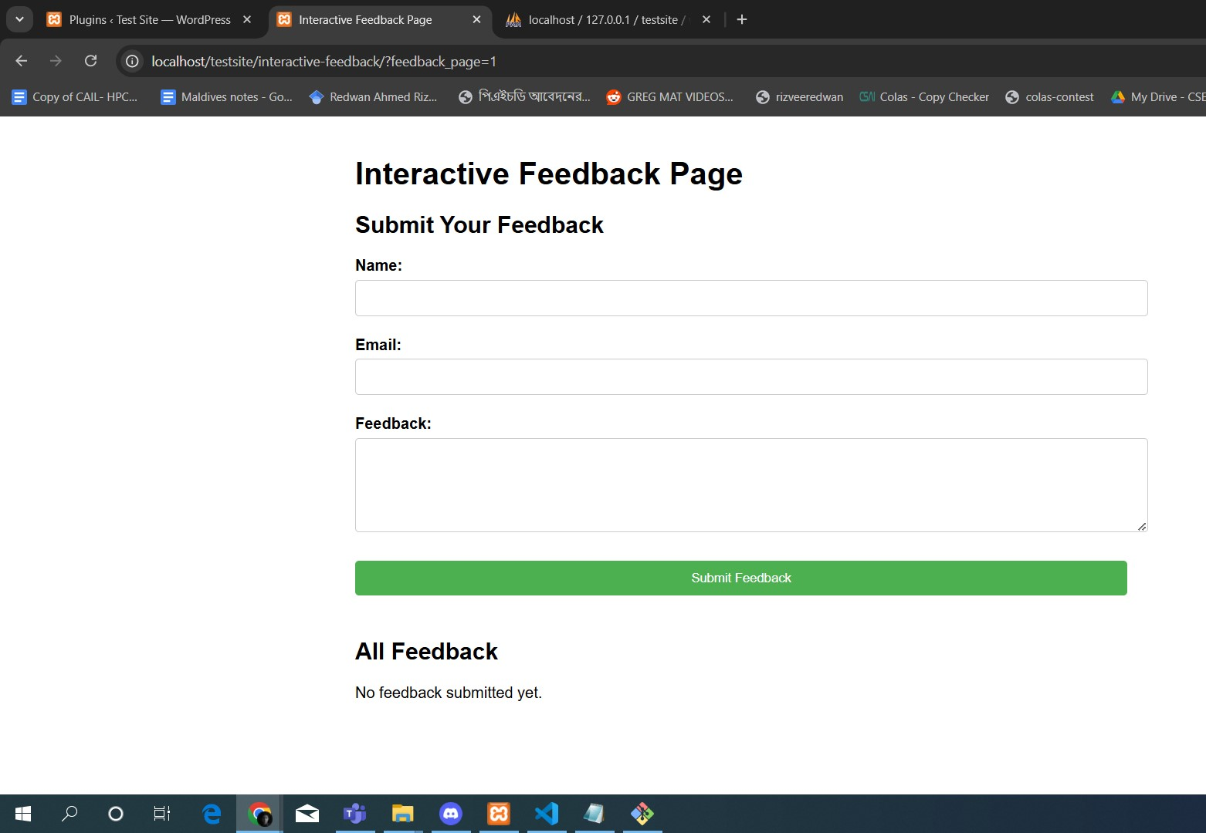
FEEDBACK PAGE

Slide 60
SEE DATABASE
GO TO http://localhost/phpmyadmin
GO TO testsite -> wp_feedback
See that your input has been stored here!
Database Name
Table Name

Slide 61
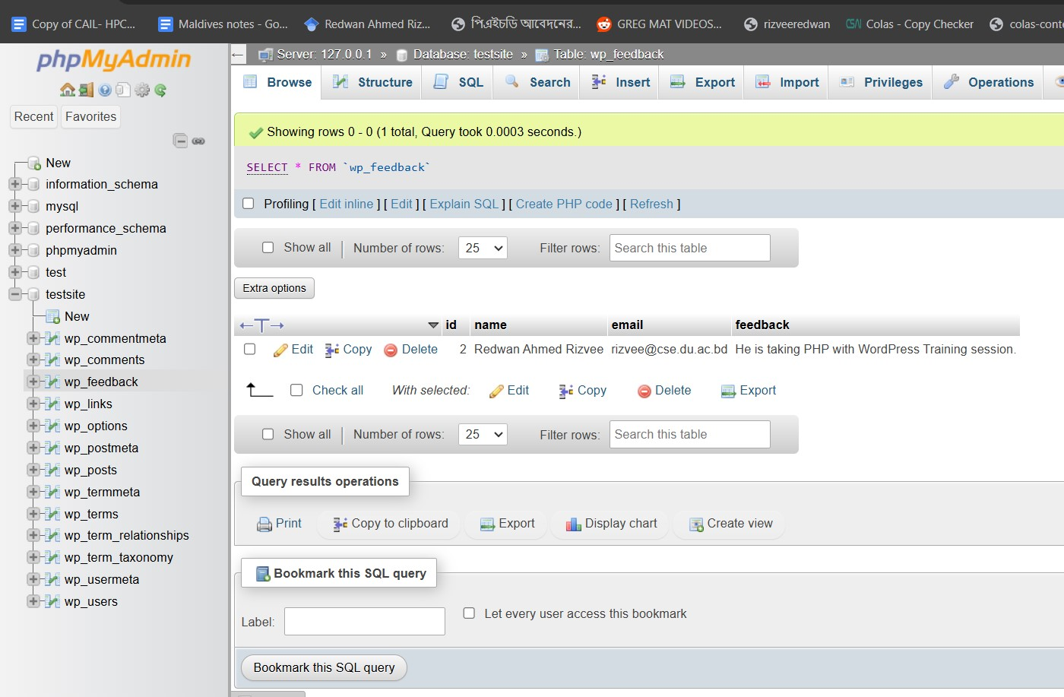
Your Given Data
Table where the data is stored

Slide 62
What is DATABASE
Database is a structured way to present the data for faster and efficient storing, update and retrieval.
We are going to use MySQL, which stores the data in a tabular format.
Unique key
Table Fields

Slide 63
SQL QUERy EXAMPLES
TABLE CREATION:
CREATE TABLE wp_feedback (
id BIGINT(20) UNSIGNED NOT NULL AUTO_INCREMENT,
name VARCHAR(100) NOT NULL,
email VARCHAR(100) NOT NULL,
feedback TEXT NOT NULL,
PRIMARY KEY (id)
) ;
INSERT INTO TABLE:
INSERT INTO wp_feedback (name, email, feedback) VALUES ('John Doe', 'john.doe@example.com', ‘Very Nice Human Being’);

Slide 64
SQL QUERy EXAMPLES
READ FROM TABLE:
SELECT name, email FROM wp_feedback;
DELETE FROM TABLE:
DELETE FROM wp_feedback WHERE email = ‘rizvee@cse.du.ac.bd’;
UPDATE TABLE ENTRY:
UPDATE wp_feedback SET email = redwan.csedu@gmail.com WHERE id = 1;

Slide 65
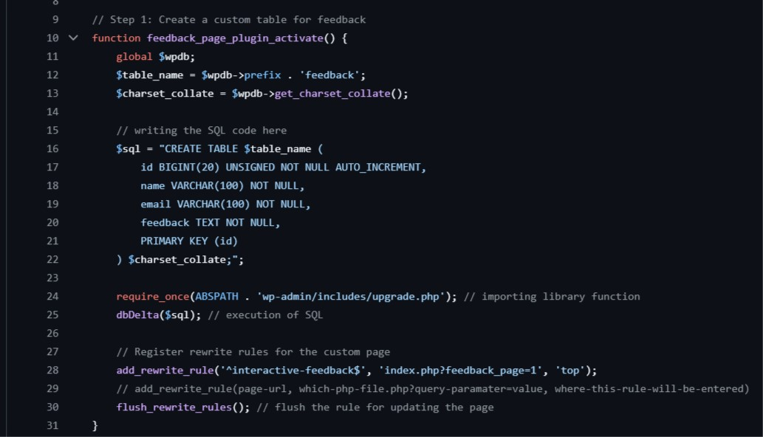
CODE THAT CREATES TABLE

Slide 66
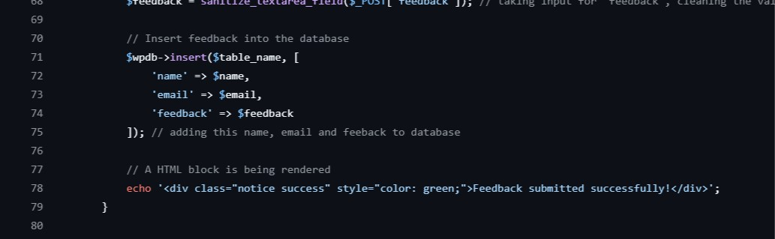
CODE THAT INSERTS NEW DATA IN THE TABLE

Slide 67

Code that brings data from the table to show !

Slide 68
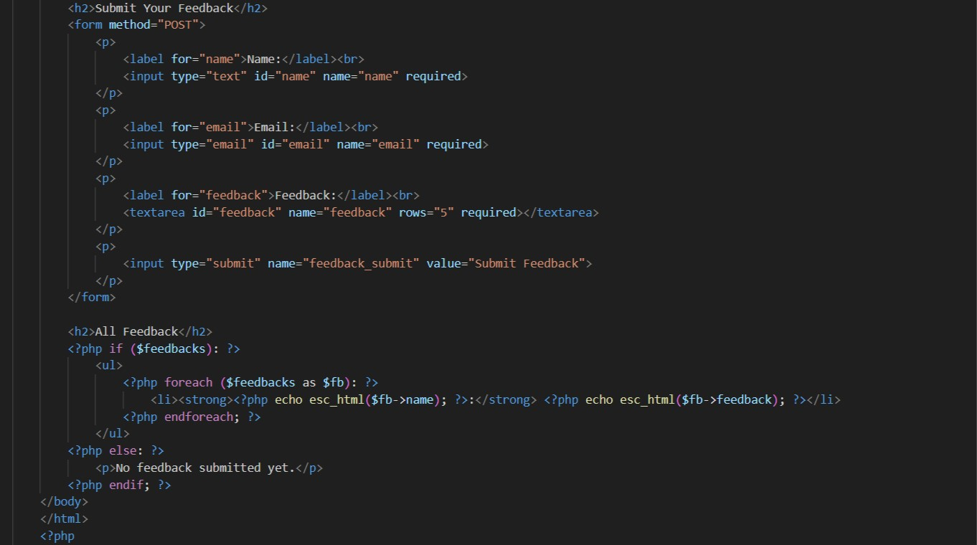
PHP WITH HTML COMBINED PORTION
SHOW THE RESULTS FROM DATABASE USING PHP and HTML

Slide 69
PlUGIN for RESUME

Slide 70
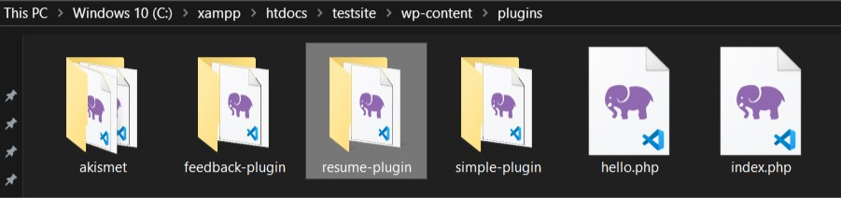
Resume plugin
We are going to create a CV/Resume using HTML, PHP and WordPress now in the form of a plugin
For simplicity, we are giving you the full code. Please find a zip folder in this link.
Download resume-plugin.zip.
Extract in C:\xampp\htdocs\testsite\wp-content\plugins. It should look like this

Slide 71
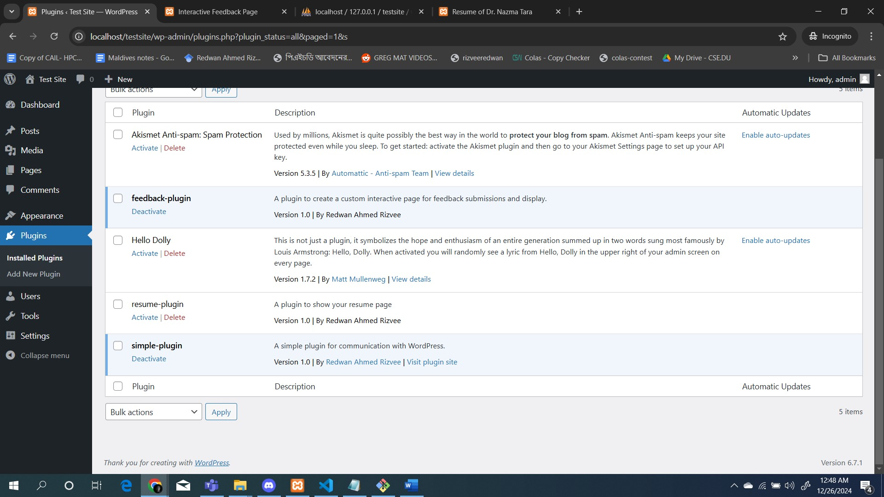
resume plugin
Activate the plugin

Slide 72
resume plugin
Go to localhost://testsite/my-resume/ and Get sample of a CV.
To update the CV, open C:\xampp\htdocs\testsite\wp-content\plugins\resume-plugin\resume-plugin.php file. Update the contents going through it ! Refresh to get any update

Slide 73
THIS IS HOW WE CAN COMBINE PHP with WORDPRESS in LOCAL HOST by creating PLUGINS
CODE REPOSITORY https://github.com/rizveeredwan/php-with-wordpress-tutorials/tree/main

Slide 74
WEBSITE Publishing through github
Create an account on Github (www.github.com)
Create a repository named your username.github.io
Keep your whole project there
Your code will start from index.html

Slide 75
THANKS!
Do you have any questions?
Dr. Sajeeb Saha
Dr. Nazma Tara
Redwan Ahmed Rizvee

